Slide 1
Motivations, Obstacles & Accomplishments of European Exploration

Slide 2
Important Vocabulary
motive
obstacle
accomplishment
goods/merchandise
empire
belief
inadequate
fear of the unknown

Slide 3
Motives

Slide 5
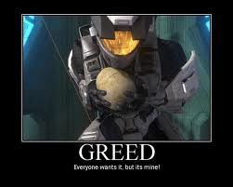
Economic=GOLD

Slide 6
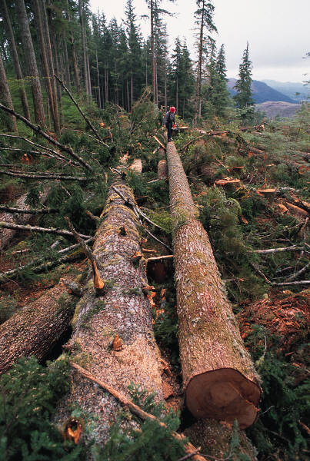
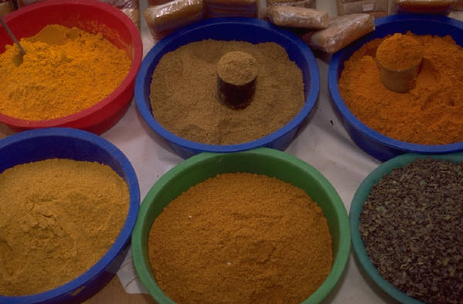
1) Natural Resources such as spices, wood & salt.

Slide 7
2) Trade of goods & ideas.

Slide 8
Religion= GOD

Slide 9
1) They wanted to spread Christianity.

Slide 10
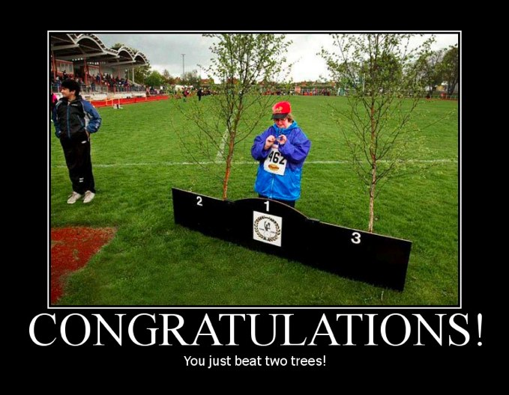
Competition= GLORY

Slide 11
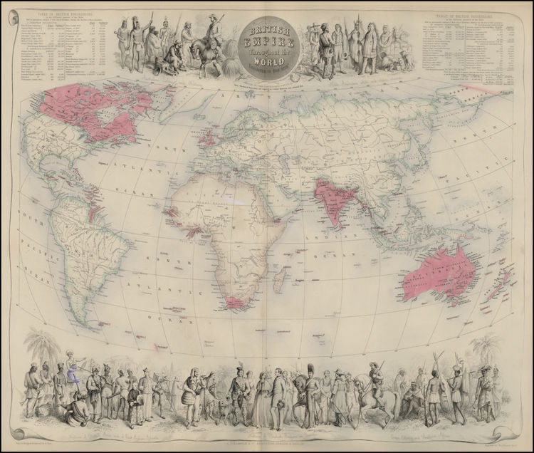
1) Build Empires

Slide 12
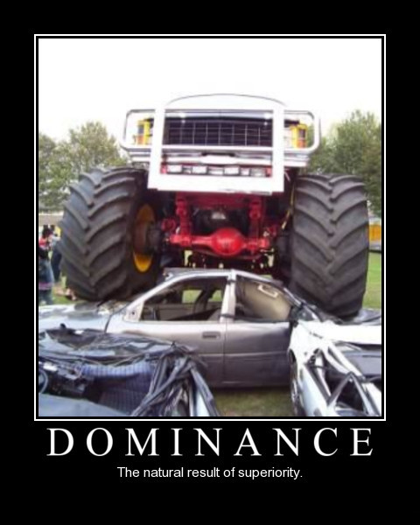
2) Belief that their culture was the best.

Slide 13
Obstacles

Slide 14
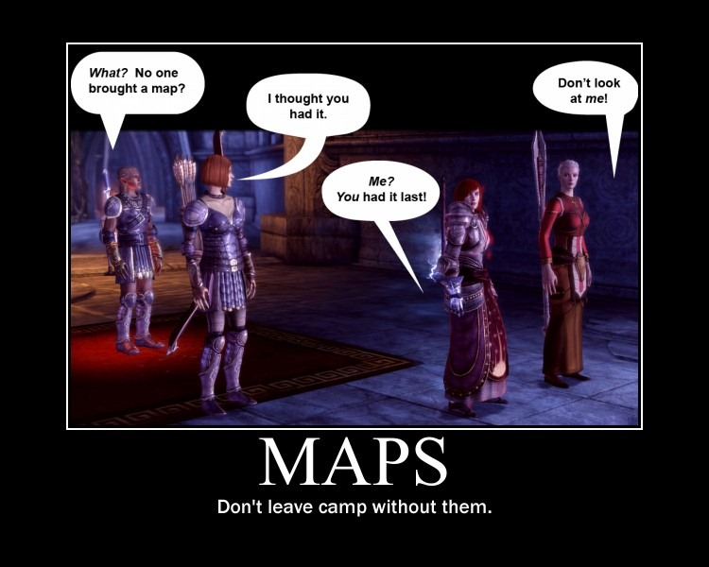
1) Poor maps

Slide 15
2) Inadequate navigational tools

Slide 16
3) Fear of the unknown.

Slide 17
4) Disease & Starvation.

Slide 18
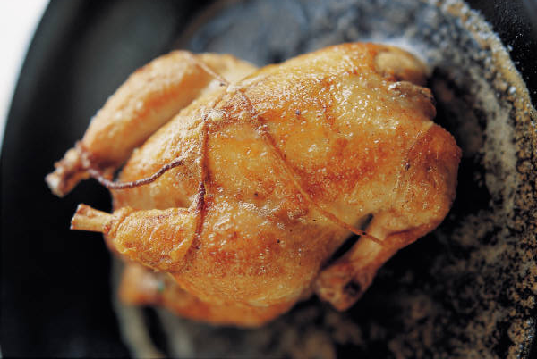
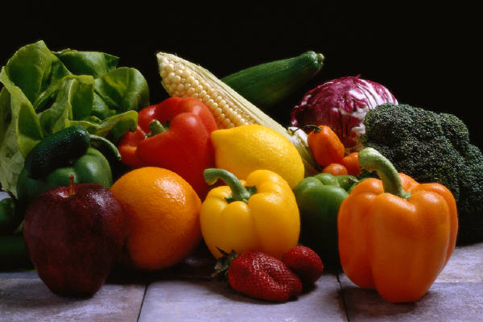
5) Lack of adequate supplies.

Slide 19
Accomplishments

Slide 20
1) Exchange of goods.

Slide 21
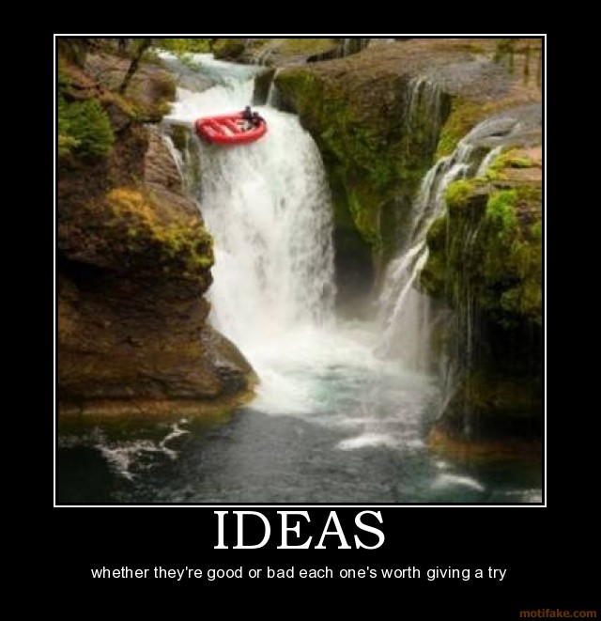
2) Exchange of ideas (like farming techniques)

Slide 22
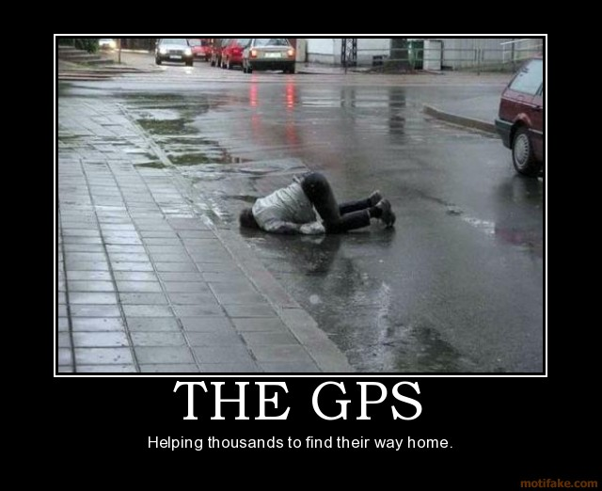
3) Improved navigational tools.

Slide 23
4) Claimed new territories.

